Slide 1
New
Tenured
Permanent
Heap
Non-Heap

Slide 2
Eden
Tenured
Permanent
Survivor
Survivor
Eden/Survivor ratio
Tenured/Young ratio
Total Heap Size

Slide 3
Eden
(Virtual)
Tenured
(Virtual)
Perm
(Virtual)
Survivor
Survivor

Slide 4
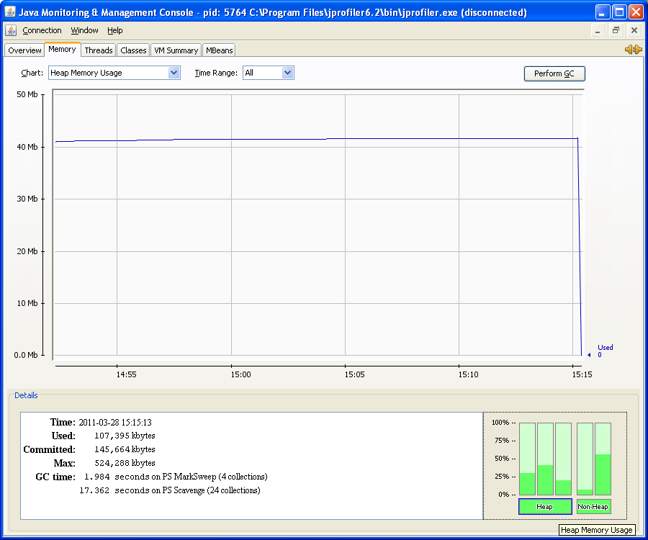
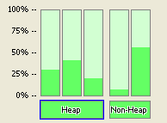

Slide 5
